Slide 1

Copyright © 2007 Ramez Elmasri and Shamkant B. Navathe Slide 1- 1

Slide 2


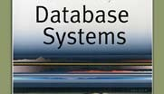

Chapter 1
Introduction: Databases and Database Users

Slide 3

Outline
Basic Definitions
Typical DBMS Functionality
Example of a Database (UNIVERSITY)
Main Characteristics of the Database Approach
Database Users
Advantages of Using the Database Approach
When Not to Use Databases

Slide 4

Basic Definitions
Data:
Known facts that can be recorded and have an implicit meaning.
Database:
A collection of related data. It has the following implicit properties:
A database represents some aspect of the real world, sometimes called the miniworld.
A database is a logically coherent collection of data with some inherent meaning.
A database is designed, built, and populated with data for specific purpose.
Examples: Airline reservation system, Students’ registration system
Database Management System (DBMS):
A software package/ system to facilitate the creation and maintenance of a computerized database.
Database System:
The DBMS software together with the data itself. Sometimes, the applications are also included.

Slide 5

Managing Data
There are two approaches to manage data
File-based approach: An approach that utilizes a collection of application programs which performs services to end-users (e.g. Reports). Each program defines and manages its own data.
Database approach: An approach that data is collected and manipulated using specific software called Database Management System, and many programs share this data.

Slide 6


File-Based Approach
User 1
Application programs
Data
Application programs
Data
User 2

Slide 7

Database Approach
User 1
Application programs
DBMS
Database
User 2
Application programs

Slide 8

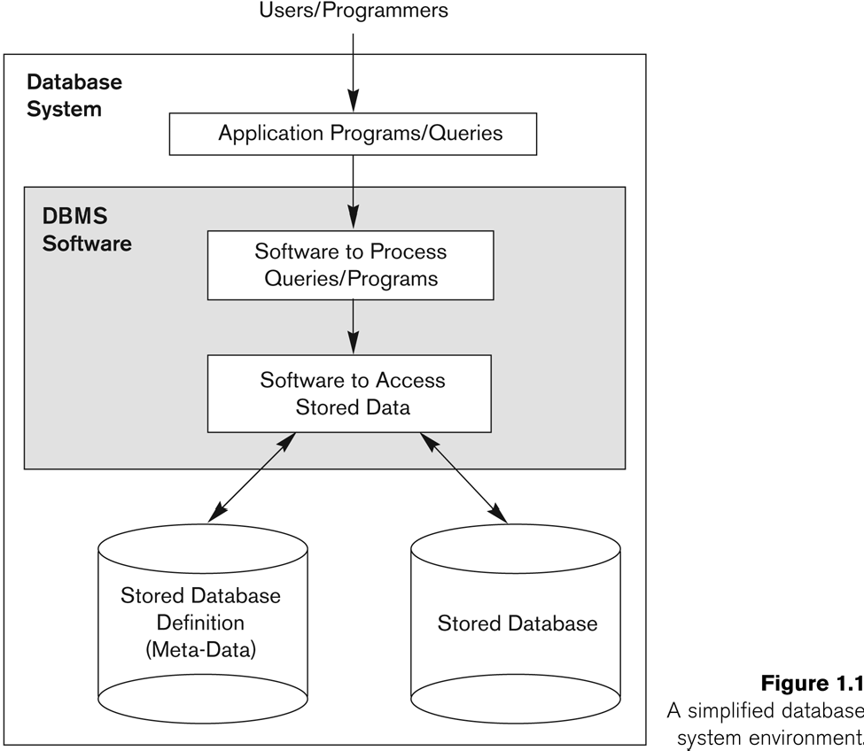
Simplified database system environment

Slide 9

Typical DBMS Functionality
Define a particular database in terms of its data types, structures, and constraints
Construct or load the initial database contents on a secondary storage medium
Manipulating the database:
Retrieval: Querying, generating reports
Modification: Insertions, deletions and updates to its content
Accessing the database through Web applications
Processing and Sharing by a set of concurrent users and application programs – yet, keeping all data valid and consistent

Slide 10

Typical DBMS Functionality
Other features:
Protection or Security measures to prevent unauthorized access
Maintaining the database and associated programs over the lifetime of the database application

Slide 11

Example of a Database
(with a Conceptual Data Model)
Mini-world for the example:
Part of a UNIVERSITY environment.
Some mini-world entities:
STUDENTs
COURSEs
SECTIONs (of COURSEs)
DEPARTMENTs
INSTRUCTORs

Slide 12

Example of a Database
(with a Conceptual Data Model)
Some mini-world relationships:
SECTIONs are of specific COURSEs
STUDENTs take SECTIONs
COURSEs have prerequisite COURSEs
INSTRUCTORs teach SECTIONs
COURSEs are offered by DEPARTMENTs
STUDENTs major in DEPARTMENTs
Note: The above entities and relationships are typically expressed in a conceptual data model, such as the ENTITY-RELATIONSHIP data model (see Chapters 3, 4)

Slide 13
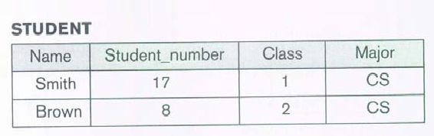
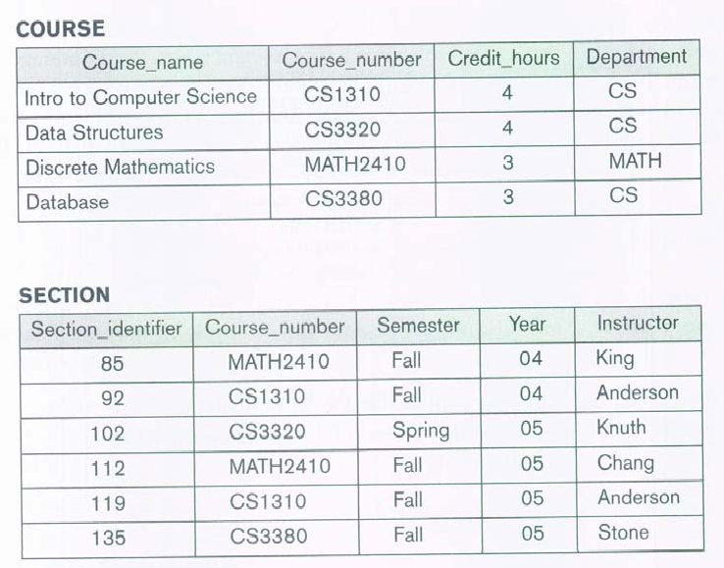
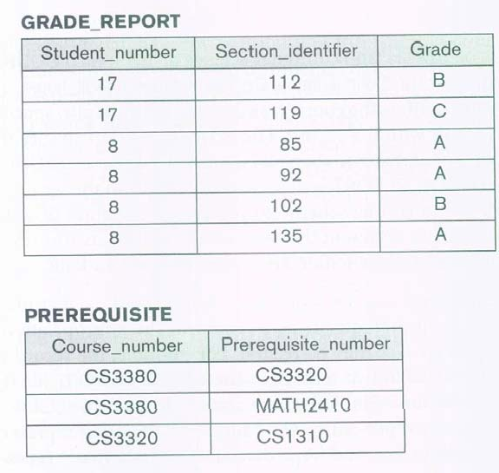
Example of a simple database

Slide 14

Main Characteristics of the Database Approach
Self-describing nature of a database system:
A DBMS catalog stores the description of a particular database (e.g. data structures, types, and constraints)
The description is called meta-data.
This allows the DBMS software to work with different database applications.
Insulation between programs and data:
Called program-data independence.
Allows changing data structures and storage organization without having to change the DBMS access programs.
Support of multiple views of the data:
Each user may see a different view of the database, which describes only the data of interest to that user.

Slide 15
Main Characteristics of the Database Approach (continued)
Sharing of data and multi-user transaction processing:
Allowing a set of concurrent users to retrieve from and to update the database.
Concurrency control within the DBMS guarantees that each
transaction is correctly executed or aborted
Recovery subsystem ensures each completed transaction has its effect permanently recorded in the database. Similarly, each failed transaction is rolled back.
OLTP (Online Transaction Processing) is a major part of database applications. This allows hundreds of concurrent transactions to execute per second.

Slide 16

Database Users
Actors on the Scene: They actually use and control the database content; and design, develop and maintain database applications
Database Administrators
Database Designers
Software Engineers
End-users
Workers Behind the Scene
Those who design and develop the DBMS software and related tools.

Slide 17

Database Users
Actors on the scene
Database administrators:
Responsible for authorizing access to the database, for coordinating and monitoring its use, acquiring software and hardware resources, controlling its use and monitoring efficiency of operations.
Database Designers:
Responsible to define the content, the structure, the constraints, and functions or transactions against the database. They must communicate with the
end-users and understand their needs.

Slide 18

Categories of End-users
Actors on the Scene:
End-users: Are those who require access to the database for querying, updating, and generating reports. They are categorized as:
Casual end-users: occasionally access the database, but they may need different information each time.
Naive or parametric end-users: constantly update and query databases, using standard types of queries and updates.
Sophisticated end-users: thoroughly familiarize themselves with the facilities of the DBMS so as to implement their application to meet their complex requirements.
Stand-alone end-users: maintain personal databases by using easy-to-use ready-made program packages.

Slide 19

Advantages of Using the Database Approach
Controlling redundancy in data storage and in development and maintenance efforts.
Sharing of data among multiple users.
Restricting unauthorized access to data.
Providing persistent storage for program Objects
In Object-oriented DBMSs
Providing Storage Structures (e.g. indexes) for efficient Query Processing

Slide 20

Advantages of Using the Database Approach (continued)
Providing backup and recovery services.
Providing multiple interfaces to different classes of users.
Representing complex relationships among data.
Enforcing integrity constraints on the database.
Permitting actions using active rules
triggers, stored procedures

Slide 21

Additional Implications of Using the Database Approach
Potential for enforcing standards:
for data item names, display formats, screens, report structures, Web page layouts, etc.
Reduced application development time
Flexibility to change data structures:
When requirements change
Availability of current information:
Extremely important for on-line transaction systems such as airline, hotel, car reservations.
Economies of scale:
Wasteful overlap of resources and personnel can be avoided by consolidating data and applications across departments.

Slide 22
When not to use a DBMS
Main inhibitors (costs) of using a DBMS:
High initial investment and possible need for additional hardware.
Overhead for providing generality, security, concurrency control, recovery, and integrity functions.
When a DBMS may be unnecessary:
If the database and applications are simple, well defined, and not expected to change.
If there are real-time requirements that may not be met because of DBMS overhead.
If access to data by multiple users is not required
When no DBMS may suffice:
If the database system is not able to handle the complexity of data because of modeling limitations
If the database users need special operations not supported by the DBMS.

